Slide 1
Array & Strings

Slide 2
Need of Array Variable
Suppose we need to store rollno of the student in the integer variable.
Now we need to store rollno of 100 students.
This is not appropriate to declare these many integer variables.
e.g. 100 integer variables for rollno.
Solution to declare and store multiple variables of similar type is an array.
An array is a variable that can store multiple values.
Declaration
int rollno;
Declaration
int rollno101, rollno102, rollno103, rollno104...;

Slide 3
Definition: Array
An array is a fixed size sequential collection of elements of same data type grouped under single variable name.
[0] | [1] | [2] | … | [99]
int rollno[100];
Fixed Size
Here, the size of an array is 100 (fixed) to store rollno
Sequential
It is indexed to 0 to 99 in sequence
Same Data type
All the elements (0-99) will be integer variables
Single Name
All the elements (0-99) will be referred as a common name rollno

Slide 4
Declaring an array
Syntax
By default array index starts with 0.
If we declare an array of size 5 then its index ranges from 0 to 4.
First element will be store at mark[0] and last element will be stored at mark[4] not mark[5].
Like integer and float array we can declare array of type char.
data-type variable-name[size];
Integer Array
[0] | [1] | [2] | [3] | [4]
int mark[5];
integer
Float Array
[0] | [1] | [2] | [3] | [4]
float avg[5];
float

Slide 5
Initialing and Accessing an Array
Declaring, initializing and accessing single integer variable
int mark=90; //variable mark is initialized with value 90
printf("%d",mark); //mark value printed
Declaring, initializing and accessing integer array variable
int mark[5]={85,75,76,55,45}; //mark is initialized with 5 values
printf("%d",mark[0]); //prints 85
printf("%d",mark[1]); //prints 75
printf("%d",mark[2]); //prints 65
printf("%d",mark[3]); //prints 55
printf("%d",mark[4]); //prints 45
[0] | [1] | [2] | [3] | [4]
85 | 75 | 65 | 55 | 45
mark[5]

Slide 6
Read(Scan) Array Elements
Reading array without loop
Reading array using loop
1
2
3
4
5
6
7
8
9
10
11
12
13
14
15
16
17
18
void main()
{
int mark[5];
printf("Enter array element=");
scanf("%d",&mark[0]);
printf("Enter array element=");
scanf("%d",&mark[1]);
printf("Enter array element=");
scanf("%d",&mark[2]);
printf("Enter array element=");
scanf("%d",&mark[3]);
printf("Enter array element=");
scanf("%d",&mark[4]);
printf("%d",mark[0]);
printf("%d",mark[1]);
printf("%d",mark[2]);
printf("%d",mark[3]);
printf("%d",mark[4]);
}
1
2
3
4
5
6
7
8
9
10
11
12
void main()
{
int mark[5],i;
for(i=0;i<5;i++)
{
printf("Enter array element=");
scanf("%d",&mark[i]);
}
for(i=0;i<5;i++)
{
printf("%d",mark[i]);
}
}
[0] | [1] | [2] | [3] | [4]
85 | 75 | 65 | 55 | 45
mark[5]

Slide 7
Develop a program to count number of positive or negative number from an array of 10 numbers.
Program
1
2
3
4
5
6
7
8
9
10
11
12
13
14
15
16
17
18
void main(){
int num[10],i,pos,neg;
pos = 0;
neg = 0;
for(i=0;i<10;i++)
{
printf("Enter array element=");
scanf("%d",&num[i]);
}
for(i=0;i<10;i++)
{
if(num[i]>0)
pos=pos+1;
else
neg=neg+1;
}
printf("Positive=%d,Negative=%d",pos,neg);
}
Output
Enter array element=1
Enter array element=2
Enter array element=3
Enter array element=4
Enter array element=5
Enter array element=-1
Enter array element=-2
Enter array element=3
Enter array element=4
Enter array element=5
Positive=8,Negative=2

Slide 8
Develop a program to read n numbers in an array and print them in reverse order.
Program
1
2
3
4
5
6
7
8
9
10
11
12
13
14
15
16
17
void main()
{
int num[100],n,i;
printf("Enter number of array elements=");
scanf("%d",&n);
//loop will scan n elements only
for(i=0;i<n;i++)
{
printf("Enter array element=");
scanf("%d",&num[i]);
}
//negative loop to print array in reverse order
for(i=n-1;i>=0;i--)
{
printf("%d\n",num[i]);
}
}
Output
Enter number of array elements=5
Enter array element=1
Enter array element=2
Enter array element=3
Enter array element=4
Enter array element=5
5
4
3
2
1

Slide 9
Practice Programs
Develop a program to calculate sum of n array elements in C.
Develop a program to calculate average of n array elements in C.
Develop a program to find largest array element in C.
Develop a program to print sum of second and second last element of an array.
Develop a program to copy array elements to another array.
Develop a program to count odd and even elements of an array.

Slide 10
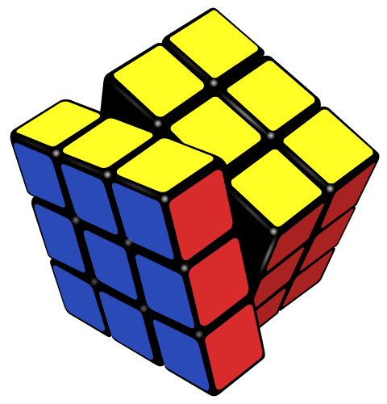
Multi Dimensional Array

Slide 11
Declaring 2 Dimensional Array
Syntax
A two dimensional array can be seen as a table with ‘x’ rows and ‘y’ columns.
The row number ranges from 0 to (x-1) and column number ranges from 0 to (y-1).
data-type variable-name[x][y];
Declaration
int data[3][3]; //This array can hold 9 elements
int data[3][3];
 | Column-0 | Column-1 | Column-2
Row-0 | data[0][0] | data[0][1] | data[0][2]
Row-1 | data[1][0] | data[1][1] | data[1][2]
Row-2 | data[2][0] | data[2][1] | data[2][2]

Slide 12
Initialing and Accessing a 2D Array: Example-1
Program
1
2
3
4
5
6
7
8
9
10
11
12
13
14
15
16
int data[3][3] = {
{1,2,3}, //row 0 with 3 elements
{4,5,6}, //row 1 with 3 elements
{7,8,9} //row 2 with 3 elements
};
printf("%d",data[0][0]); //1
printf("%d",data[0][1]); //2
printf("%d\n",data[0][2]); //3
printf("%d",data[1][0]); //4
printf("%d",data[1][1]); //5
printf("%d\n",data[1][2]); //6
printf("%d",data[2][0]);//7
printf("%d",data[2][1]); //8
printf("%d",data[2][2]); //9
 | Column-0 | Column-1 | Column-2
Row-0 | 1 | 2 | 3
Row-1 | 4 | 5 | 6
Row-2 | 7 | 8 | 9
1
2
// data[3][3] can be initialized like this also
int data[3][3]={{1,2,3},{4,5,6},{7,8,9}};

Slide 13
Initialing and Accessing a 2D Array: Example-2
Program
1
2
3
4
5
6
7
8
9
10
11
12
13
int data[2][4] = {
{1,2,3,4}, //row 0 with 4 elements
{5,6,7,8}, //row 1 with 4 elements
};
printf("%d",data[0][0]); //1
printf("%d",data[0][1]); //2
printf("%d",data[0][2]); //3
printf("%d\n",data[0][3]); //4
printf("%d",data[1][0]); //5
printf("%d",data[1][1]); //6
printf("%d",data[1][2]); //7
printf("%d",data[1][3]); //8
 | Col-0 | Col-1 | Col-2 | Col-3
Row-0 | 1 | 2 | 3 | 4
Row-1 | 5 | 6 | 7 | 8
1
2
// data[2][4] can be initialized like this also
int data[2][4]={{1,2,3,4},{5,6,7,8}};

Slide 14
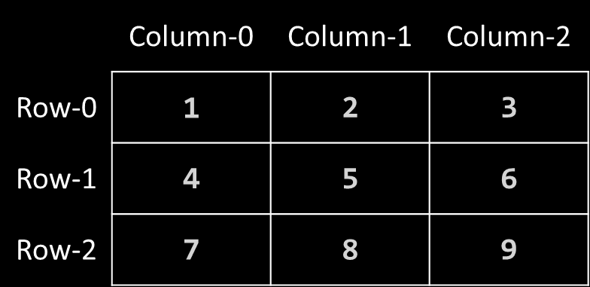
Read(Scan) 2D Array Elements
Program
1
2
3
4
5
6
7
8
9
10
11
12
13
14
15
16
17
18
19
void main(){
int data[3][3],i,j;
for(i=0;i<3;i++)
{
for(j=0;j<3;j++)
{
printf("Enter array element=");
scanf("%d",&data[i][j]);
}
}
for(i=0;i<3;i++)
{
for(j=0;j<3;j++)
{
printf("%d",data[i][j]);
}
printf("\n");
}
}
Output
Enter array element=1
Enter array element=2
Enter array element=3
Enter array element=4
Enter array element=5
Enter array element=6
Enter array element=7
Enter array element=8
Enter array element=9
123
456
789

Slide 15
Develop a program to count number of positive, negative and zero elements from 3 X 3 matrix
Program
1
2
3
4
5
6
7
8
9
10
11
12
13
14
15
16
17
18
void main(){
int data[3][3],i,j,pos=0,neg=0,zero=0;
for(i=0;i<3;i++)
{
for(j=0;j<3;j++)
{
printf("Enter array element=");
scanf("%d",&data[i][j]);
if(data[i][j]>0)
pos=pos+1;
else if(data[i][j]<0)
neg=neg+1;
else
zero=zero+1;
}
}
printf("positive=%d,negative=%d,zero=%d",pos,neg,zero);
}
Output
Enter array element=9
Enter array element=5
Enter array element=6
Enter array element=-3
Enter array element=-7
Enter array element=0
Enter array element=11
Enter array element=13
Enter array element=8
positive=6,negative=2,zero=1

Slide 16
Practice Programs
Develop a program to perform addition of two matrix.
Develop a program to perform multiplication of two matrix.

Slide 17
String (Character Array)

Slide 18
Definition: String
A String is a one-dimensional array of characters terminated by a null('\0').
Each character in the array occupies one byte of memory, and the last character must always be null('\0').
The termination character ('\0') is important in a string to identify where the string ends.
[0] | [1] | [2] | … | [9]
char name[10];
[0] | [1] | [2] | [3] | [4] | [5] | [6] | [7] | [8] | [9]
D | A | R | S | H | A | N | \0
name[10]

Slide 19
Declaring & Initializing String
Declaration
char name[10];
Initialization method 1:
char name[10]={'D','A','R','S','H','A','N','\0'};
Initialization method 2:
char name[10]="DARSHAN";
//'\0' will be automatically inserted at the end in this type of declaration.
[0] | [1] | [2] | [3] | [4] | [5] | [6] | [7] | [8] | [9]
D | A | R | S | H | A | N | \0
name[10]

Slide 20
Read String: scanf()
Program
Output
1
2
3
4
5
6
7
void main()
{
char name[10];
printf("Enter name:");
scanf("%s",name);
printf("Name=%s",name);
}
Enter name: Darshan
Name=Darshan
Output
Enter name: CE Darshan
Name=CE
There is no need to use address of (&) operator in scanf to store a string.
As string name is an array of characters and the name of the array, i.e., name indicates the base address of the string (character array).
scanf() terminates its input on the first whitespace(space, tab, newline etc.) encountered.

Slide 21
Read String: gets()
Program
1
2
3
4
5
6
7
8
#include<stdio.h>
void main()
{
char name[10];
printf("Enter name:");
gets(name); //read string including white spaces
printf("Name=%s",name);
}
Output
Enter name:Darshan Institute
Name=Darshan Institute
gets(): Reads characters from the standard input and stores them as a string.
puts(): Prints characters from the standard.
scanf(): Reads input until it encounters whitespace, newline or End Of File(EOF) whereas gets() reads input until it encounters newline or End Of File(EOF).
gets(): Does not stop reading input when it encounters whitespace instead it takes whitespace as a string.

Slide 22
String Handling Functions : strlen()
C has several inbuilt functions to operate on string. These functions are known as string handling functions.
strlen(s1): returns length of a string in integer
Program
1
2
3
4
5
6
7
8
9
#include <stdio.h>
#include <string.h> //header file for string functions
void main()
{
char s1[10];
printf("Enter string:");
gets(s1);
printf("%d",strlen(s1)); // returns length of s1 in integer
}
Output
Enter string: CE Darshan
10

Slide 23
String Handling Functions: strcmp()
strcmp(s1,s2): Returns 0 if s1 and s2 are the same.
Returns less than 0 if s1<s2.
Returns greater than 0 if s1>s2.
Program
1
2
3
4
5
6
7
8
9
10
11
12
void main()
{
char s1[10],s2[10];
printf("Enter string-1:");
gets(s1);
printf("Enter string-2:");
gets(s2);
if(strcmp(s1,s2)==0)
printf("Strings are same");
else
printf("Strings are not same");
}
Output
Enter string-1:Computer
Enter string-2:Computer
Strings are same
Output
Enter string-1:Computer
Enter string-2:Computer
Strings are same

Slide 24
String Handling Functions
For examples consider: char s1[]="Their",s2[]="There";
Syntax | Description
strcpy(s1,s2) | Copies 2nd string to 1st string. strcpy(s1,s2) copies the string s2 in to string s1 so s1 is now “There”. s2 remains unchanged.
strcat(s1,s2) | Appends 2nd string at the end of 1st string. strcat(s1,s2); a copy of string s2 is appended at the end of string s1. Now s1 becomes “TheirThere”
strchr(s1,c) | Returns a pointer to the first occurrence of a given character in the string s1. printf("%s",strchr(s1,'i')); Output : ir
strstr(s1,s2) | Returns a pointer to the first occurrence of a given string s2 in string s1. printf("%s",strstr(s1,"he")); Output : heir

Slide 25
String Handling Functions (Cont…)
For examples consider: char s1[]="Their",s2[]="There";
Syntax | Description
strrev(s1) | Reverses given string. strrev(s1); makes string s1 to “riehT”
strlwr(s1) | Converts string s1 to lower case. printf("%s",strlwr(s1)); Output : their
strupr(s1) | Converts string s1 to upper case. printf("%s",strupr(s1)); Output : THEIR
strncpy(s1,s2,n) | Copies first n character of string s2 to string s1 s1=""; s2="There"; strncpy(s1,s2,2); printf("%s",s1); Output : Th
strncat(s1,s2,n) | Appends first n character of string s2 at the end of string s1. strncat(s1,s2,2); printf("%s", s1); Output : TheirTh

Slide 26
String Handling Functions (Cont…)
For examples consider: char s1[]="Their",s2[]="There";
Syntax | Description
strncmp(s1,s2,n) | Compares first n character of string s1 and s2 and returns similar result as strcmp() function. printf("%d",strcmp(s1,s2,3)); Output : 0
strrchr(s1,c) | Returns the last occurrence of a given character in a string s1. printf("%s",strrchr(s2,'e')); Output : ere

Slide 27
Thank you


